Slide 1
Residuals

Slide 2
Deviations from the overall pattern of the regression line are important.
“Left-over” variations in the response after fitting the regression line are called residuals.

Slide 3
Residuals
A residual is the difference in the observed value of the response variable and the value predicted by the regression line.
(how far the data fall from the regression line).
Residual = observed y – predicted y
Residual = y – ŷ

Slide 4
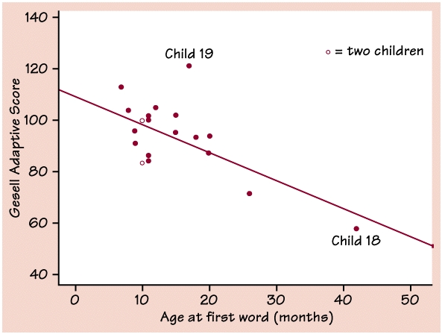
Ex: Gesell Scores
Does the age at which a child begins to talk predict later score on a test of mental ability?
Scatter plot of Gesell Adaptive scores.

Slide 5
Describe the distribution
The line is the LSRL for predicting Gesell score from age of first word.
Plot shows negative association.
Pattern is moderately (some scatter)strong and roughly linear.
Correlation r = -0.640 describes direction and strength.

Slide 6
Predictions
LSRL: ŷ = 109.8738 – 1.1270x
For a child who first spoke at 15 months, we predict:
ŷ = 109.8738 – 1.1270( )
ŷ = 92.97
The child’s actual score was 95.
Residual =
Residual = -
15
92.97
95
obsrv. y – pred. y
= 2.03

Slide 7
Residual = 2.03
The residual is positive because the data point lies above the line.

Slide 8
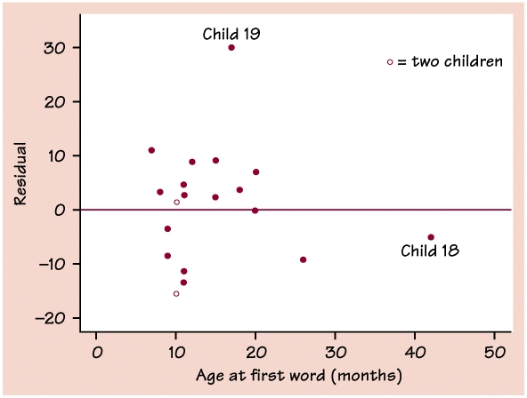
The mean of the least-squares residuals is always zero.
take into account round off error
A line at 0 is reference point that helps orient us.

Slide 9
Scatterplot and Residual plot
Residual plot for the regression of Gesell score on age of first word.
Child 19 is an outlier.
Child 18 is an influential obser. that does not have a large residual.

Slide 10
Residual Plots
A Residual Plot is a scatterplot of the regression residuals against the explanatory variable.
They help us assess the fit of a regression line.
If the regression line captures the overall relationship between x and y, the residuals should have no systematic pattern.

Slide 11
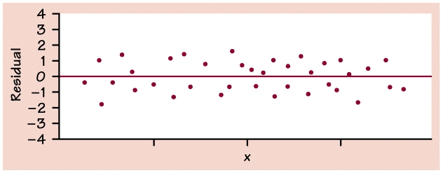
Things to look out for with residual plots
The uniform scatter of points indicates that the regression line fits the data well, so the line is a good model.

Slide 12
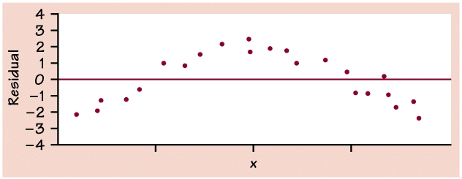
A curved pattern shows that the relationship is not linear.

Slide 13
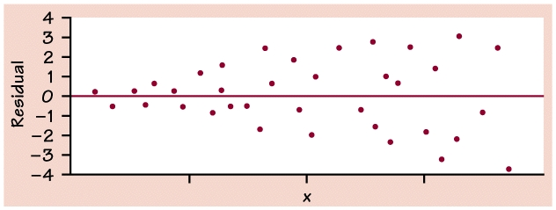
Increasing or decreasing spread about the line. The response variable y has more spread for larger values of the explanatory variable x, so the prediction will be less accurate when x is large.

Slide 14
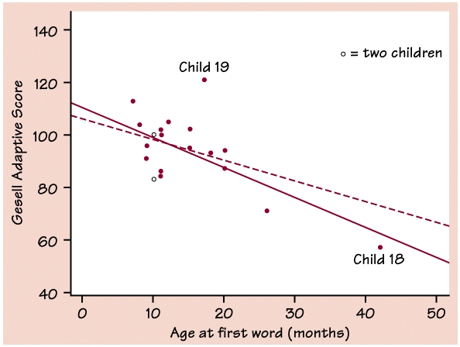
Watch out for:
Individual points with large residuals, like Child 19.
Individual points that are extreme in the x direction, like Child 18.

Slide 15
Outliers and Influential Observations in Regression
Outlier:
an observation that lies outside the overall pattern.
Influential: an observation is influential if removing it would markedly change the result of the calculation.

Slide 16
Points that are outliers in the x direction of a scatterplot are often influential for the LSRL.
The dashed line is calculated leaving out Child 18 (Influential observation).
Leaving out this observation changes the regression line quite a bit

Slide 17
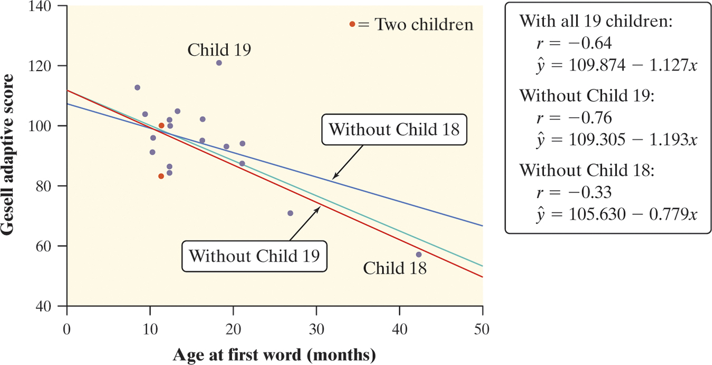
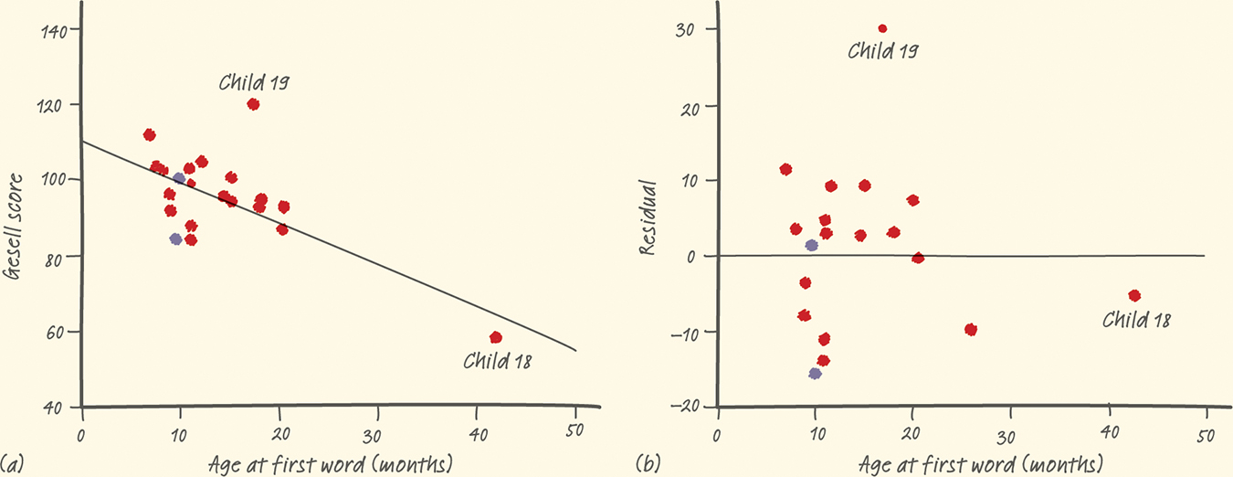
Least-Squares Regression
Correlation and Regression Wisdom
Examine the change in the LSRL when removing outlier
Child 19 and influential point child 18.
Definition:
An outlier is an observation that lies outside the overall pattern of the other observations. Points that are outliers in the y direction but not the x direction of a scatterplot have large residuals. Other outliers may not have large residuals.
An observation is influential for a statistical calculation if removing it would markedly change the result of the calculation. Points that are outliers in the x direction of a scatterplot are often influential for the least-squares regression line.

Slide 18
Classwork
Exercise 2C

